Slide 1

D.N.R. COLLEGE OF ENGINEERING &TECHNOLOGY (Approved by AICTE, New Delhi & Affiliated to SBTET, A.P) (Accredited with NAAC A++ Grade & Accredited by NBA) Balusumudi, Bhimavaram-534202, W.G.Dist A.P., II Shift Polytechnic College Code: 354 E-Mail: dnrpoly@gmail.com
MEDIPORTAL
Submitted by:
N.Srujana(23354-CM-016)
B.Purna Chandra Rao(23354-CM-027)
M.D.V.Naresh(23354-CM-042)

Slide 2
ABSTRACT
This project outlines a simple medicine delivery system designed to demonstrate how users can place medicine orders online. It allows basic functionality such as medicine selection, prescription upload, and delivery address input without using a database. The system simulates logic through temporary storage (e.g., lists or in-memory variables) and is ideal for prototyping or educational use.

Slide 3
INTRODUCTION
Access to timely medication is critical to patient care.
Manual systems are inefficient and often error-prone.
A digital solution helps reduce delays, track orders, and improve patient adherence to medication schedules.
Goal: Build a system that ensures safe, fast, and traceable medicine delivery

Slide 4
PROBLEM STATEMENT
Manual purchase and delivery of medicine are time-consuming and prone to human error.
Lack of proper tracking and coordination between pharmacies and users.
Inconvenient for elderly or disabled users to visit pharmacies.
Risk of counterfeit medicines in unregulated markets.

Slide 5
EXISTING SYSTEM
Currently, many basic online medicine delivery prototypes or simple websites are developed using only front-end technologies like HTML, CSS, and sometimes JavaScript, without integrating backend databases. These systems typically consist of static web pages where users can view a fixed list of medicines, along with their details such as name, price, and quantity available.In such systems, users can select medicines and add them to a cart during their browsing session. Client-side storage options like local Storage or session Storage are often used to temporarily save the user's selections while navigating through the site. Since there is no database connection, the system cannot permanently store orders or user information, nor does it provide dynamic updates or user authentication.These existing systems are mostly used for educational purposes, small-scale demonstrations, or environments where simplicity and ease of deployment are prioritized over scalability and real-time functionality. They serve as a basic framework to understand how online ordering interfaces work without the complexity of backend integration.Want me to cover how these systems could be improved or what limitations they have?

Slide 6
DISADVANTAGES
Limited dynamic functionality and real-time updates.
Absence of user authentication and account management.
Manual updating of medicine lists in the HTML code.
No payment gateway integration.
Poor scalability for handling many users or orders.

Slide 7
PROPOSED SYSTEM
A user-friendly web interface built with HTML to display medicine details.
Use of client-side storage (like localStorage or sessionStorage) to temporarily save user selections during the session.
Simple order placement without requiring backend database or server-side processing.
Static pages that allow browsing medicines, adding items to a cart, and viewing the cart before “placing” an order.
Basic validation using JavaScript to ensure correct input formats.
Suitable for small-scale or prototype applications where persistent data and advanced features are not required.

Slide 8
ADVANTAGES
Online medicine delivery is highly convenient because it allows customers to order medicines anytime without leaving their homes.
It saves significant time by removing the need to travel to a pharmacy and wait in lines.
This system increases accessibility by making medicines available to people in remote or underserved areas.
Online delivery ensures privacy for users, enabling discreet purchases especially for sensitive health conditions.
It is cost-effective, as customers can compare prices and take advantage of discounts offered by different vendors.

Slide 9
SYSTEM REQUIREMENTS
Hardware Requirements
Processor: Intel i3 or higher
RAM: 4 GB minimum
Storage: 500 MB for development files
Display: 1024x768 resolution or higher

Slide 10
Software Requirements:
Operating System: Windows/Linux/macOS/Android
Web browser or mobile app
IDE for development: VS Code, PyCharm, or similar
No database required – data is held in temporary storage (e.g., Python lists)
Storage: Temporary in-memory lists (no database)

Slide 11
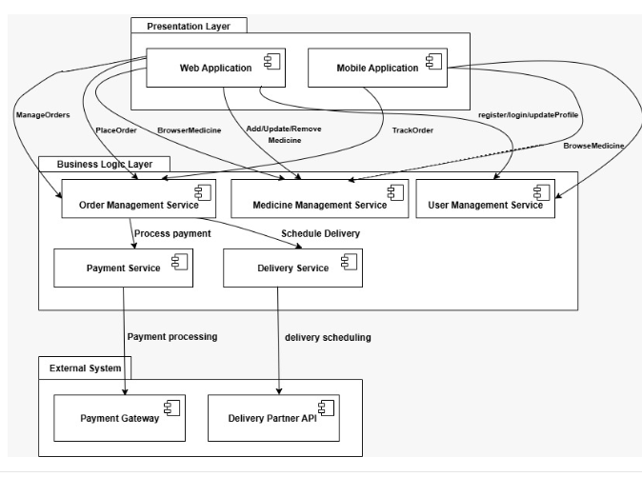
SYSTEM DESIGN
SYSTEM ARCHITECHTURE:

Slide 12
ALGORITHM USED
The system displays a list of available medicines statically on the webpage since there is no database to fetch from.
Users select medicines and specify quantity via HTML form elements like checkboxes or dropdowns.
When the user submits the order form, the system collects order details using basic client-side scripting (JavaScript) or form submission.
The system calculates the total price and displays an order summary dynamically on the page without needing to store data on a server.
The user enters delivery details manually into the form (name, address, contact info).
Upon confirmation, the system generates a printable or downloadable receipt showing the order and delivery details.
Since there is no backend or database, the order is not stored; the user is advised to contact the pharmacy manually or via provided contact info.
The system can optionally send order details via email using a client mailto link, but no automated processing is done.

Slide 13
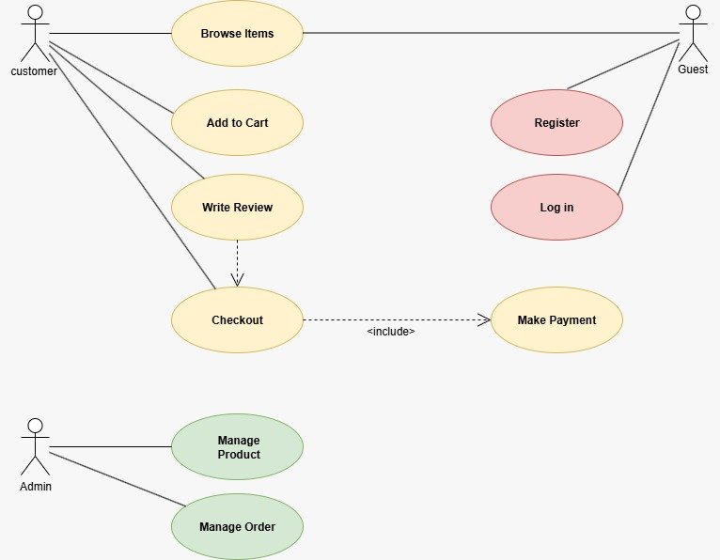
UML DIAGRAMS
USECASE DIAGRAM:

Slide 14
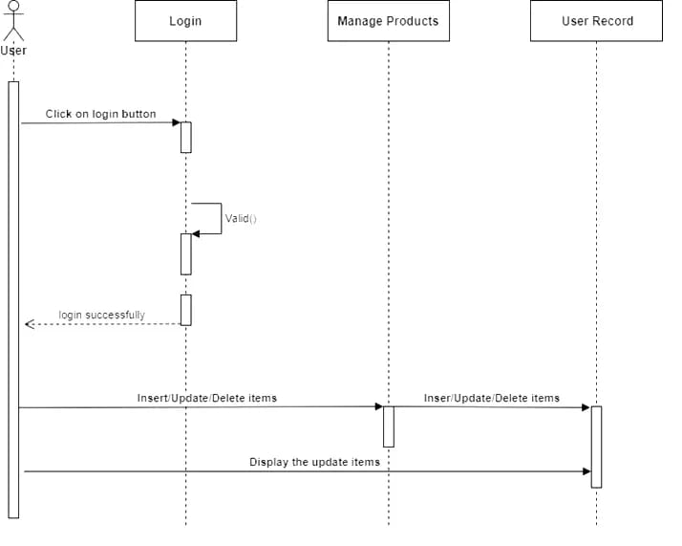
COLLABORATION DIAGRAM:

Slide 15
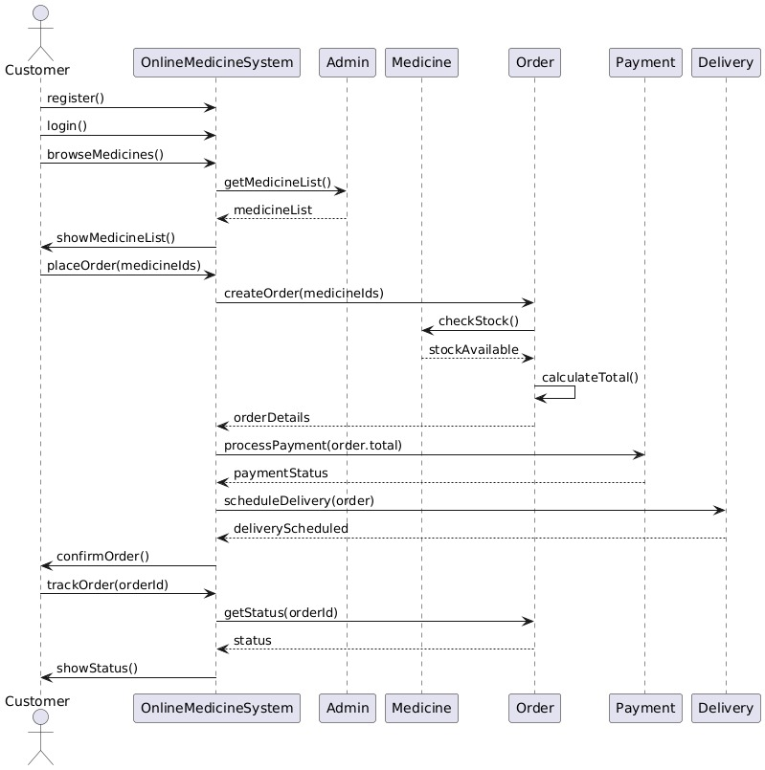
SEQUENCE DIAGRAM:

Slide 16
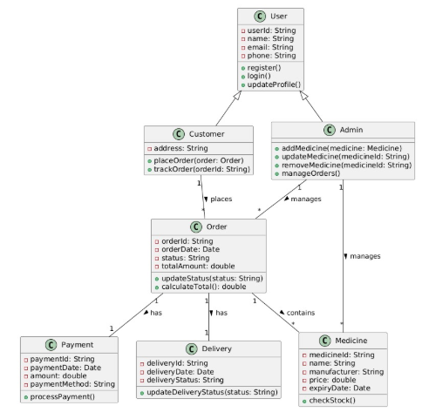
CLASS DIAGRAM:

Slide 17
TESTCASES
Test Case ID | Description | Input | Expected Output | Notes
01 | Add a new medicine delivery request | Valid medicine, quantity, address, phone | Success message, request added | Validate inputs
02 | Add request with missing fields | Missing medicine name or phone | Error: "Required fields missing" | Input validation
03 | View all delivery requests | N/A | List of all delivery requests | Show empty list if none
04 | Search request by medicine name | Medicine name | List of matching requests | Case insensitive search
05 | Search request by phone number | Valid phone number | Requests linked to phone number | Validate phone format
06 | Update existing delivery request | Valid Request ID, new quantity/address | Success message, updated request | Request ID must exist
07 | Update non-existing request | Invalid Request ID | Error: "Request not found" | Handle invalid IDs
08 | Delete a delivery request | Valid Request ID | Success message, request removed | Request ID must exist
09 | Delete non-existing request | Invalid Request ID | Error: "Request not found" | Robust deletion check
10 | Add request with invalid phone number | Phone: "abc123" | Error: "Invalid phone number format" | Input validation

Slide 18
LANGUAGES USED
HTML (HyperText Markup Language):Used to design the structure and layout of the web pages.
CSS (Cascading Style Sheets):Used to style the web pages and make the interface attractive and user-friendly.
JavaScript:Used to add interactivity and handle client-side logic for dynamic content.
Firebase (Backend Service):Used for authentication, database management, and web hosting.

Slide 19
METHODOLOGY
Requirement Analysis: Identify user needs and system goals.
Design: Create wireframes and UI mockups.
Development: Code using HTML, CSS, and JavaScript.
Testing: Validate functionality and fix bugs.
Deployment: Host the application online.
Feedback & Iteration: Improve based on user input.

Slide 20
IMPLEMENTATION
Developed using modular JavaScript functions
Responsive design with CSS Flexbox/Grid
Medicine data stored in JSON or Firebase
Cart and order logic handled via JavaScript
Alerts and confirmations for user actions

Slide 21
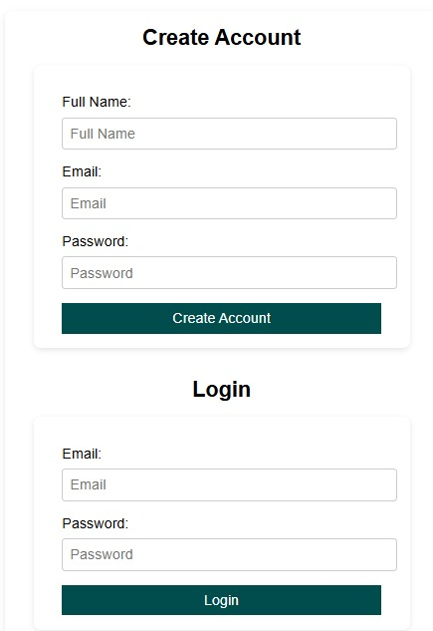
RESULT ANALYSIS

Slide 22
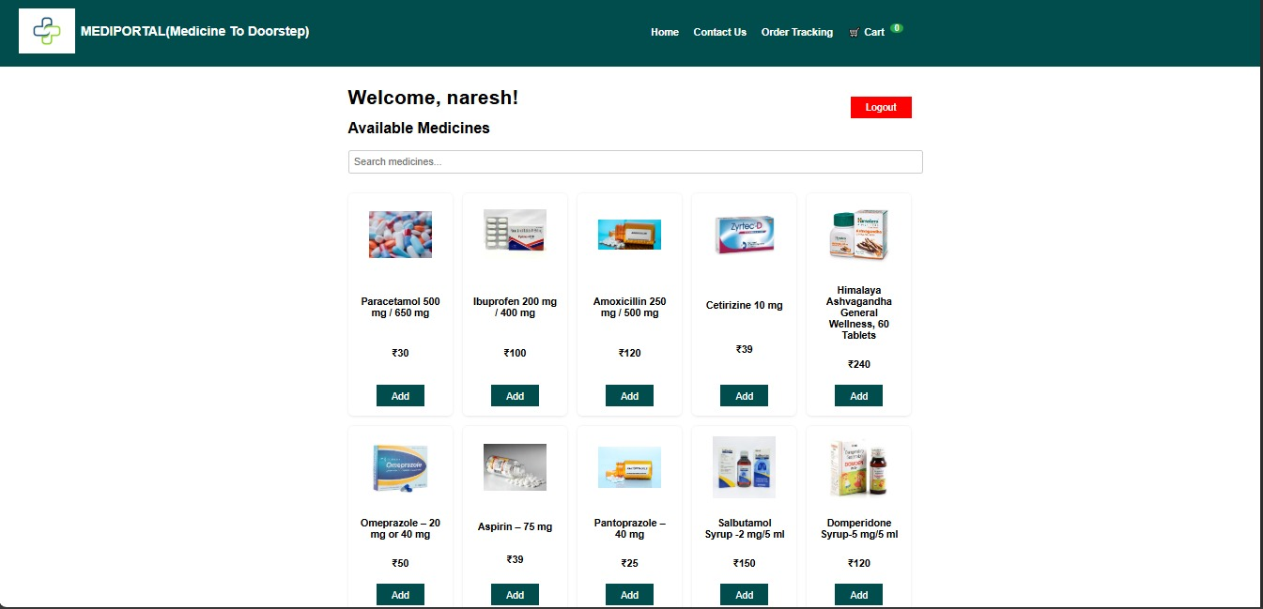

Slide 23
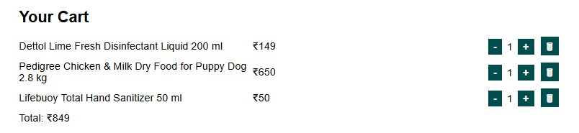

Slide 24
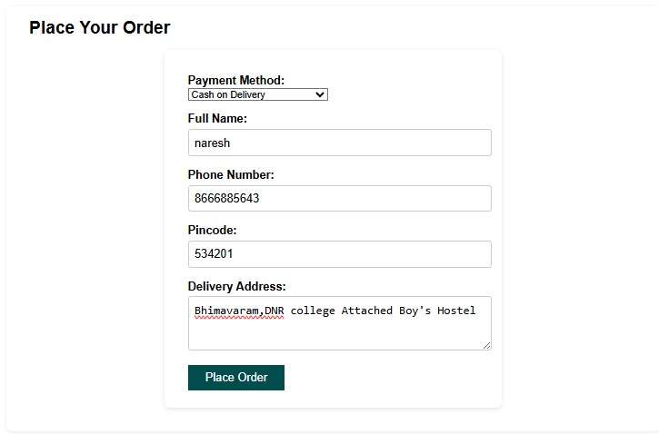

Slide 25
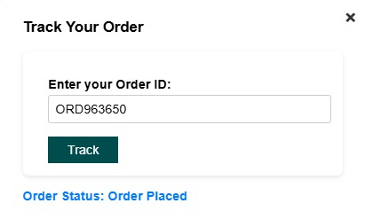

Slide 26
CONCLUSION
In conclusion, the medicine delivery system prototype offers a lightweight, accessible, and functional solution for ordering medicines online without relying on a database. By using only frontend technologies and Python with Flask, the system effectively simulates the medicine ordering process using temporary in-memory storage. Although it lacks data persistence, this approach is ideal for prototyping, educational purposes, and proof-of-concept presentations. The system highlights the core functionality of a medicine delivery platform and sets a foundation for future enhancements, such as integrating a database, user authentication, and real-time delivery tracking.

Slide 27
FUTURE SCOPE
The system can evolve by integrating a backend database to store orders, user profiles, and medicine inventories, enabling dynamic content and better management.
Adding payment gateway integration will allow users to pay online securely, enhancing convenience and trust.
Implementing real-time order tracking features can improve user experience by providing updates on delivery status.
Incorporating AI-based medicine recommendations could personalize user experience and improve health outcomes.
Mobile app development alongside the web system would make the service more accessible and user-friendly on smart phones.
Expanding to support multi-language interfaces will cater to a wider demographic, increasing accessibility.
Adding automated notifications and reminders via SMS or email will improve medication adherence and refill rates.

Slide 28
https://mediportal2-design.github.io/mediportal/
MediPortal is a web-based application focused on medicine delivery and management.
The interface includes options for viewing medicines, managing delivery, and placing orders.
The design features a clean, simple layout with navigation menus on the left sidebar.
It includes functionalities like searching medicines, adding them to cart, and tracking orders.
The homepage or dashboard displays medicine categories and delivery status updates.

Slide 29
THANK YOU

